Slide 1
Generating Audio Descriptions for Videos Using Contrastive Language-Image Pre-Training (CLIP) Interrogation
Julia Chen
Mobile Web Application Development Research Lab

Slide 2
01
Introduction

Slide 3
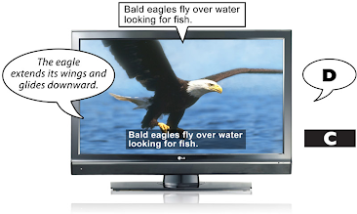
Context
Audio descriptions
  Provide blind and low vision individuals information about key visual elements of a video
  Typically manually transcribed

Slide 4
Objective
Create an algorithm that generates audio descriptions of videos for blind and low vision individuals
Audio descriptions should be
  Concise
  Accurate
  Generated efficiently

Slide 5
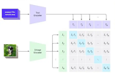
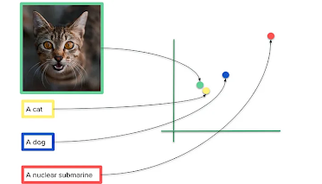
Background
Contrastive Language-Image Pre-training (CLIP)
  Embeds images and text to a shared vector space
  Embeddings are optimized during training

Slide 6
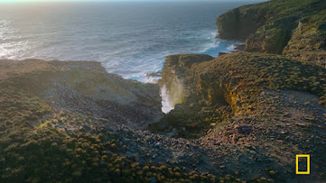
Background
Image Interrogation
  Generates prompt that would have produced the given image
a cliff with a waterfall in the middle, imax 7. 0 mm footage, imax photography 4 k, ocean cliff view, cinematic lens flare, beautiful cinematography, anamorphic lens flares, stunning cinematography, anamorphic lens flare, neil blomkamp film landscape, shot on anamorphic lenses, anamorphic cinematography, imax cinematography

Slide 7
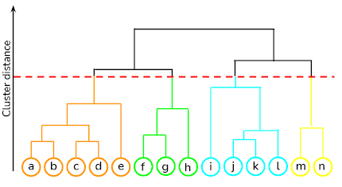
Background
Hierarchical clustering
  Creates clusters of different granularities

Slide 8
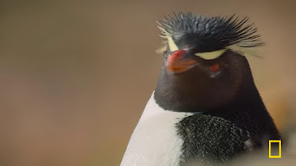
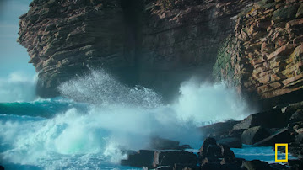
Background
JPEG file size
  Quantify image complexity
185 KB
422 KB

Slide 9
02
Methodology

Slide 10




Libraries
OpenCV 2 (cv2)
scipy
gTTS
pydub

Slide 11
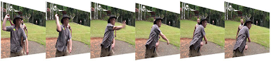

Algorithm Design
Frame selection
  Separate video into frames
  Quantify using JPEG image size
→
493 KB

Slide 12
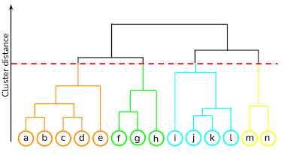
Algorithm Design
Frame selection
  Perform hierarchical clustering
  Select frame in center of each cluster

Slide 13
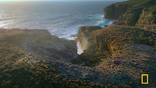
Algorithm Design
Description generation
  CLIP Interrogator analyzes selected frames
  Description generated is associated with the cluster the frame represents
→
a cliff with a waterfall in the middle

Slide 14
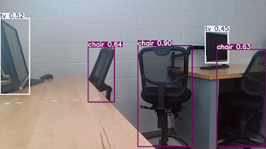
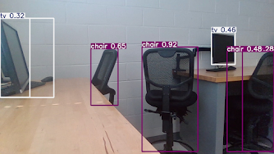
Challenges
You Only Look Once Version 11 (YOLOv11)
  As frame selection metric
3 chairs, 2 tvs
4 chairs, 3 tvs

Slide 15
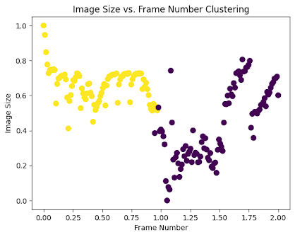
Challenges
K-means clustering
  As frame selection algorithm

Slide 16
03
Results and Discussion

Slide 17
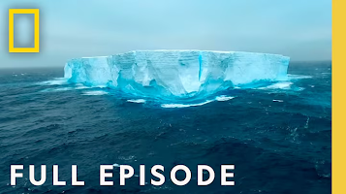
Input Video
Clip from Antarctica: Home at the End of the Earth
  Concrete subjects and landscapes
  Camera pans, moving subjects, and jump cuts

Slide 18
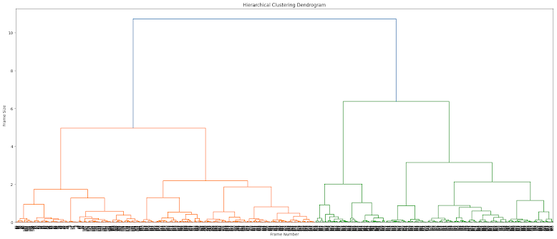
Results

Slide 19














Results

Slide 20
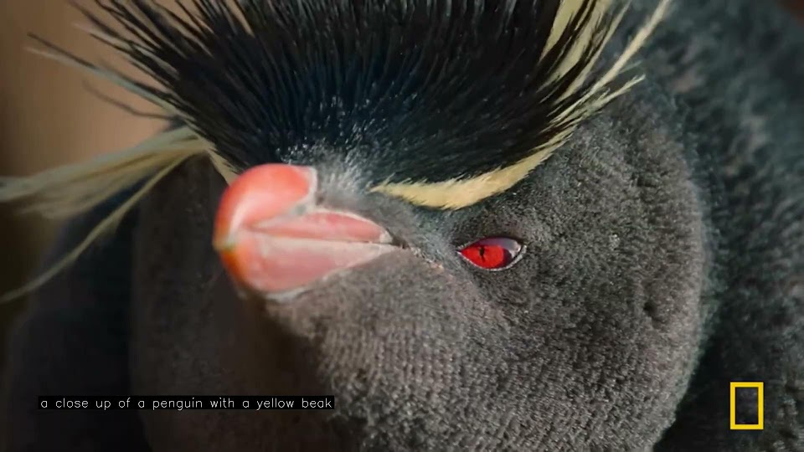

Slide 21
Successes
Descriptions are concise
Frequency of descriptions
Some accurate descriptions
Frame selection algorithm
  Selects representative frames

Slide 22
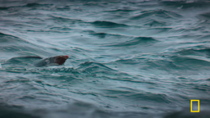
Limitations
Inaccurate descriptions
  Unable to consider context
Audio description alignment
Expensive runtime
  12 seconds of processing per second of video
A seal swimming in the ocean

Slide 23
04
Conclusion

Slide 24
Significance
Developed novel algorithm to generate audio descriptions
  Frame selection
    Hierarchical clustering on JPEG image sizes
  Description generation
    CLIP interrogation

Slide 25
Future Work
Optimizing runtime
Improving CLIP model
  Description generation that considers previous context
Improving clusters to align with video jump cuts

Slide 26
Acknowledgements
Special thanks to Mr. Kosek for guiding and advising me for this project and thank you to my peers for providing feedback and support.

Slide 27
Thank you!
Any questions?

